Slide 1
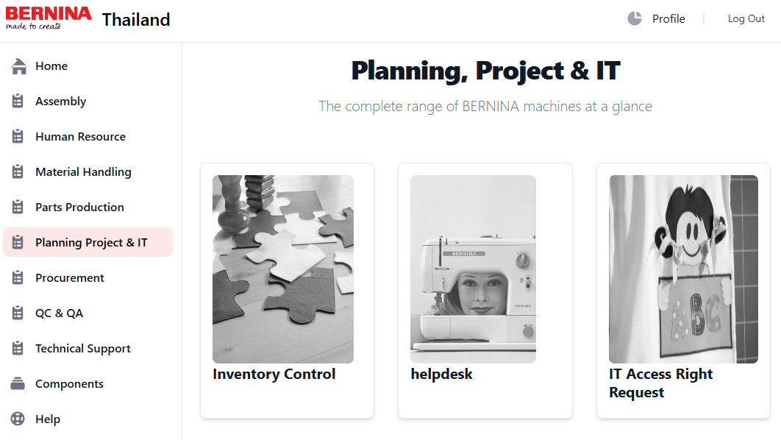
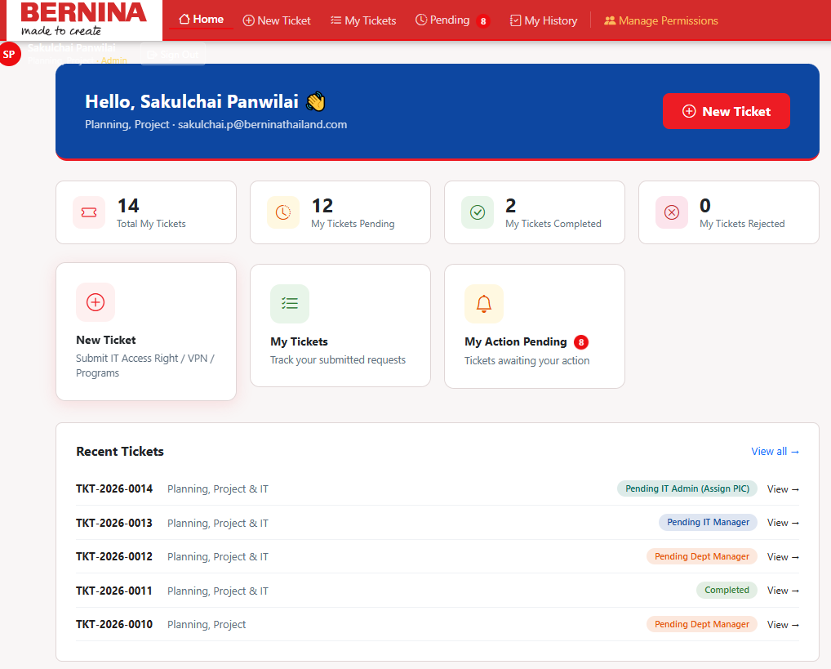
IT Access Right Request Update V200
Objective
Critical update
Revise User Interface
Requester, Approval, Historical Tracking

Slide 2
IT Access Right Request Update V200
Document Flow
User (Employee) Access Right Form
Person In Charge
- Department Mgr.
- Employee
Department Manager
Approval
- Cross department Mgr.
- Employee PIC
IT Manager
Approval
IT Admin Close Task
IT Admin Assign task

Slide 3
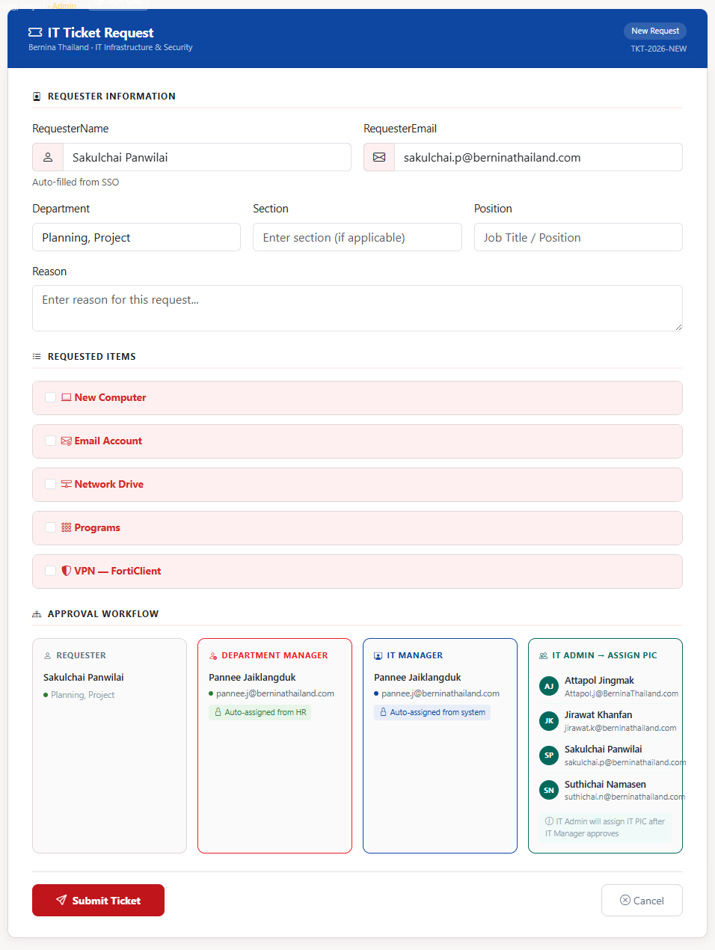
IT Access Right Request Update V200
Requester: New Request.
For All User with @berninathailand.com

Slide 4
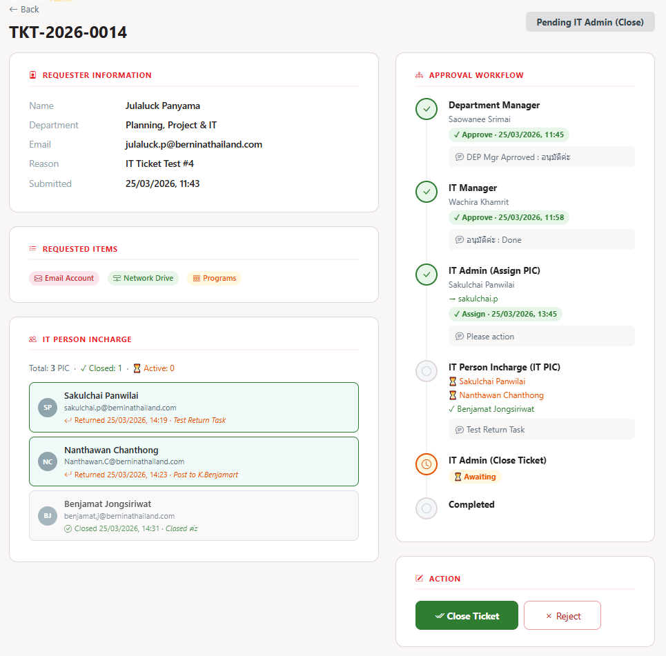
IT Access Right Request Update V200
Approver: - Manager
- Cross department (Require Dep. Mgr.) - Employee (PIC).

Slide 5
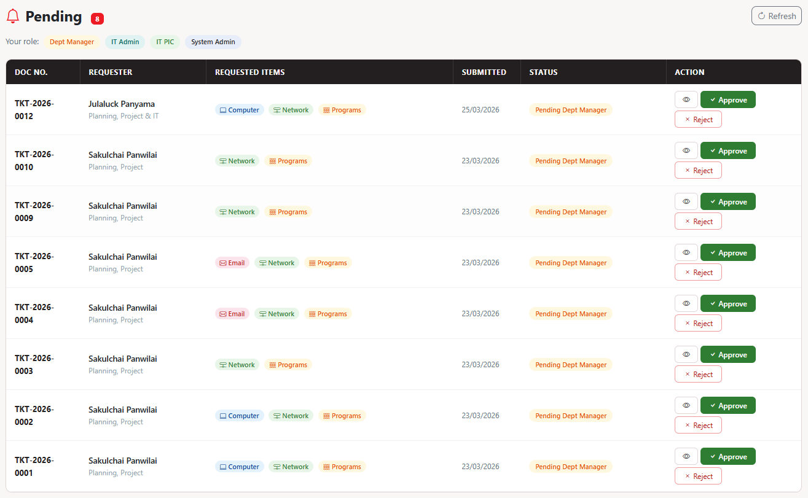
IT Access Right Request Update V200

Slide 6
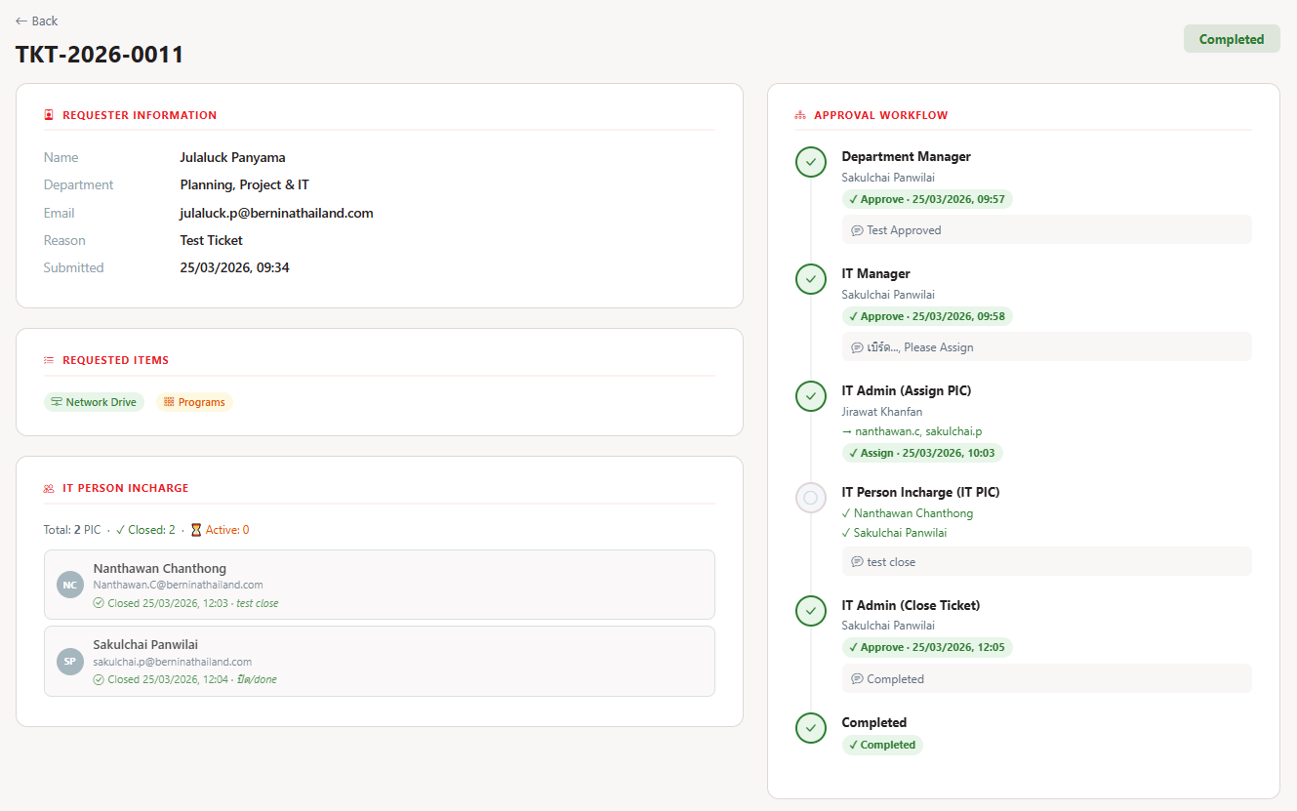
IT Access Right Request Update V200

Slide 7
IT Access Right Request Update V200
Thanks.

